Slide 1
Intro to Deep Learning for the Absolute Beginner Lecture 3
Esteban (EJ) Guillen
https://github.com/EstebanGuillen/DeepLearningClass
Notes:
Hello and welcome to this course on Deep Learning

Slide 2
Lesson 9 – Setting up AWS
8 – AWS VMs
P3.2xlarge – V100 GPU!
You will need to remote desktop into your Windows machine
Install Putty - https://www.putty.org/
Notes:
Timebox this activity to 15 minutes

Slide 3
Configuring an AWS EC2 instance
Following slide should work for Mac and Linux
We will walk through Windows setup
https://docs.aws.amazon.com/AWSEC2/latest/UserGuide/putty.html
https://docs.aws.amazon.com/dlami/latest/devguide/setup-jupyter-configure-client-windows.html
https://docs.aws.amazon.com/dlami/latest/devguide/setup-jupyter-login.html

Slide 4

Launch a new Instance
Notes:
Click ”Launch Instance”

Slide 5
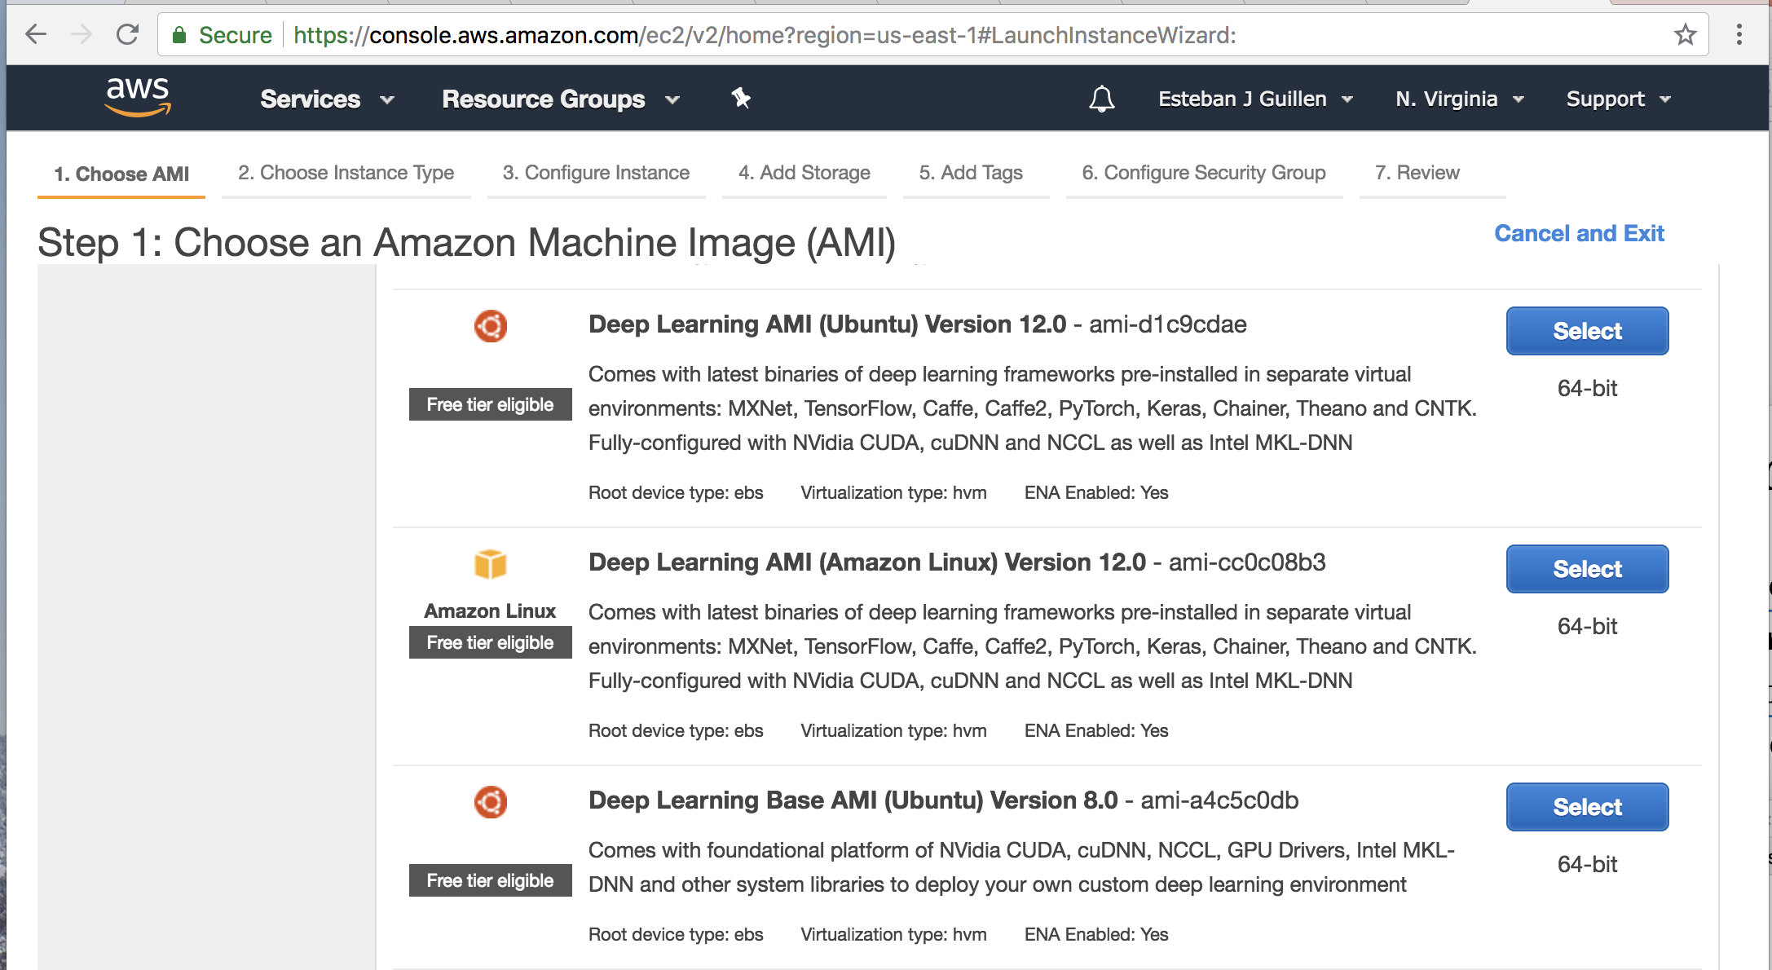
Select the Deep Learning AMI
Notes:
Select the Deep Learning AMI (Ubuntu)

Slide 6
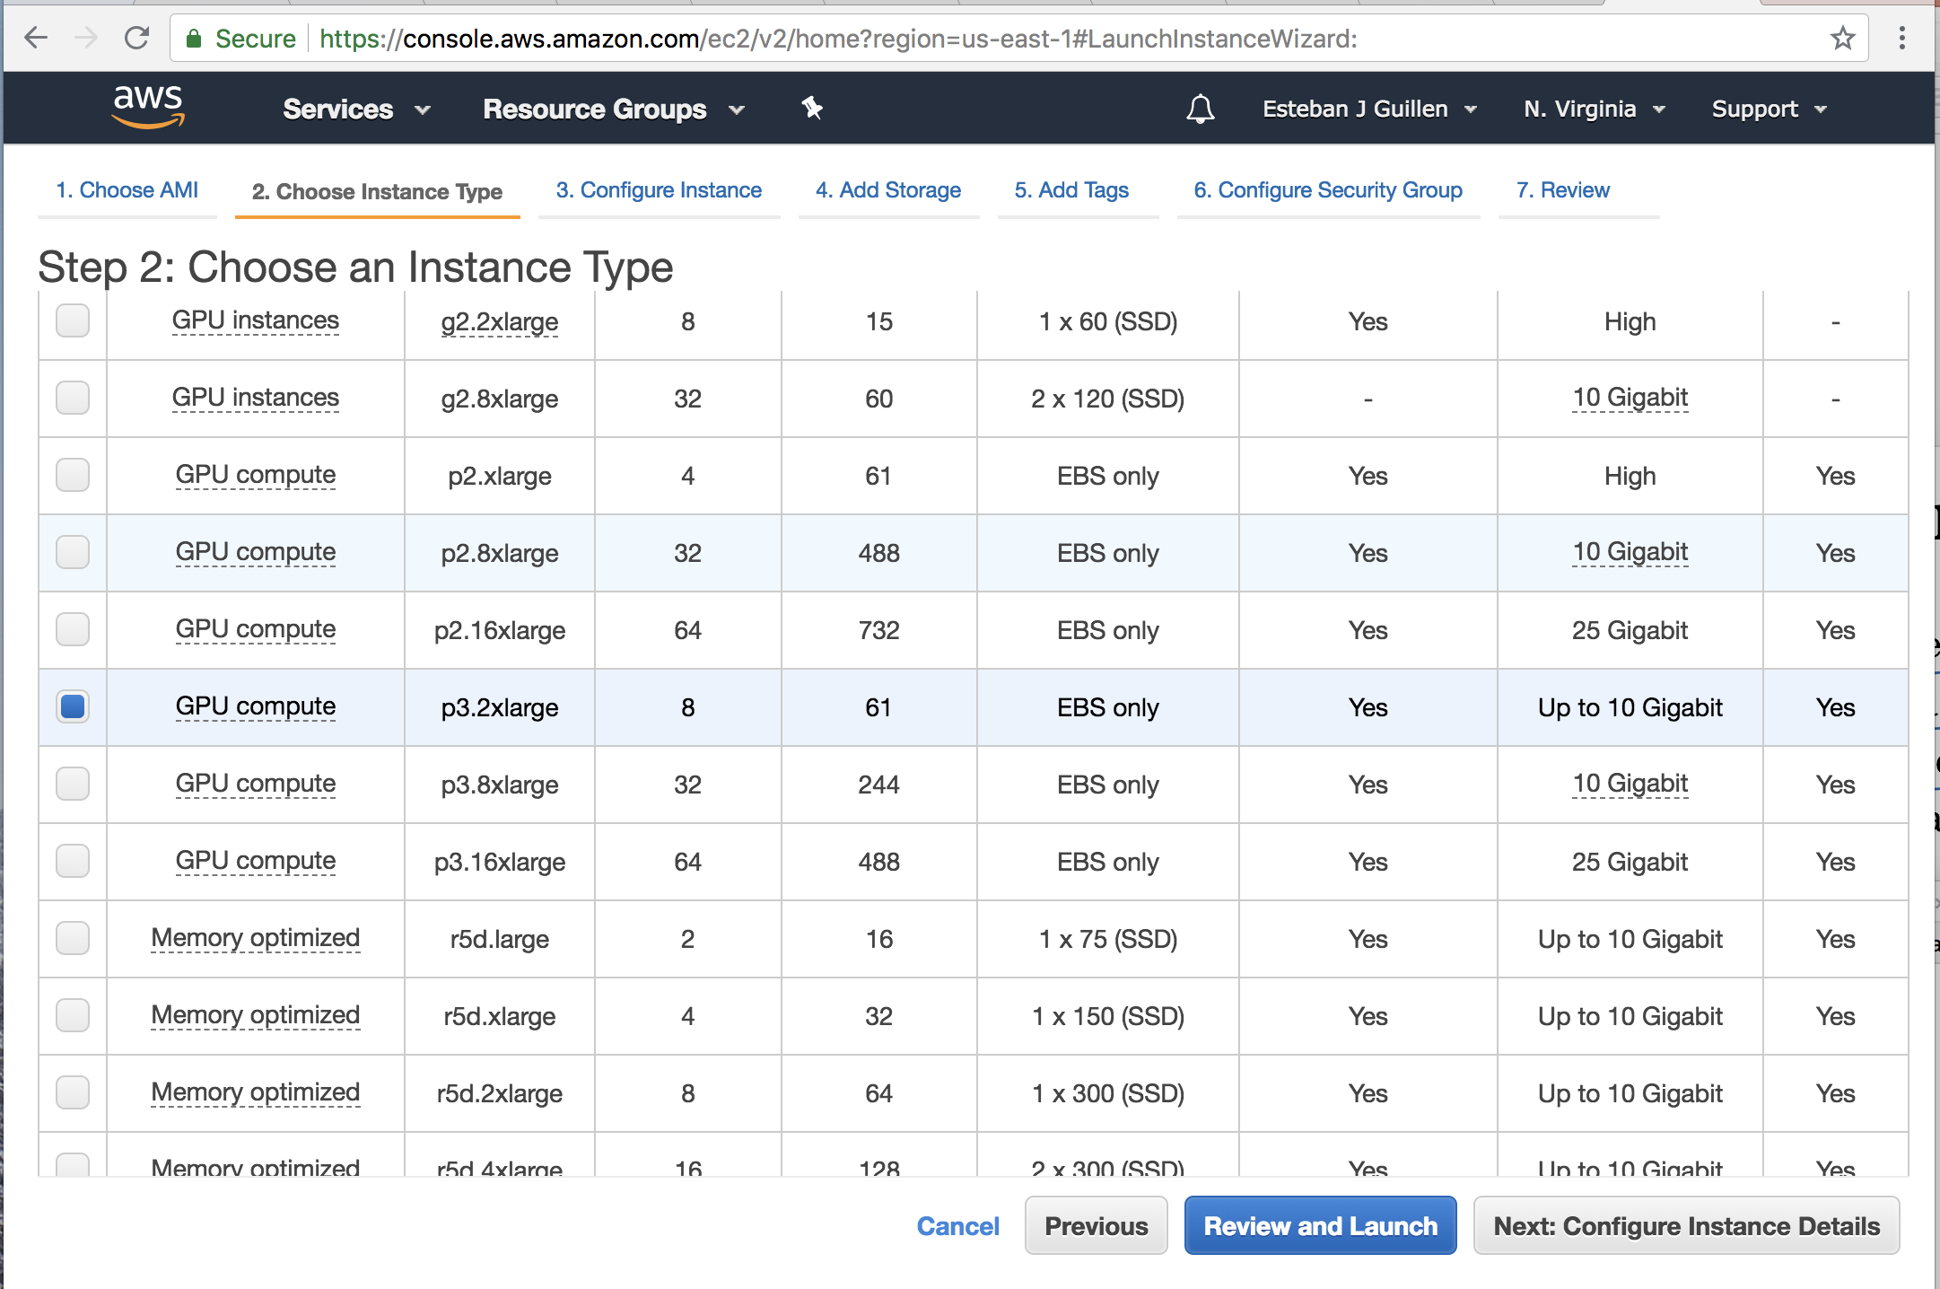
Select p3.2xlarge -> Review and Launch
Notes:
Select p3.3xlarge and click Review and Launch

Slide 7
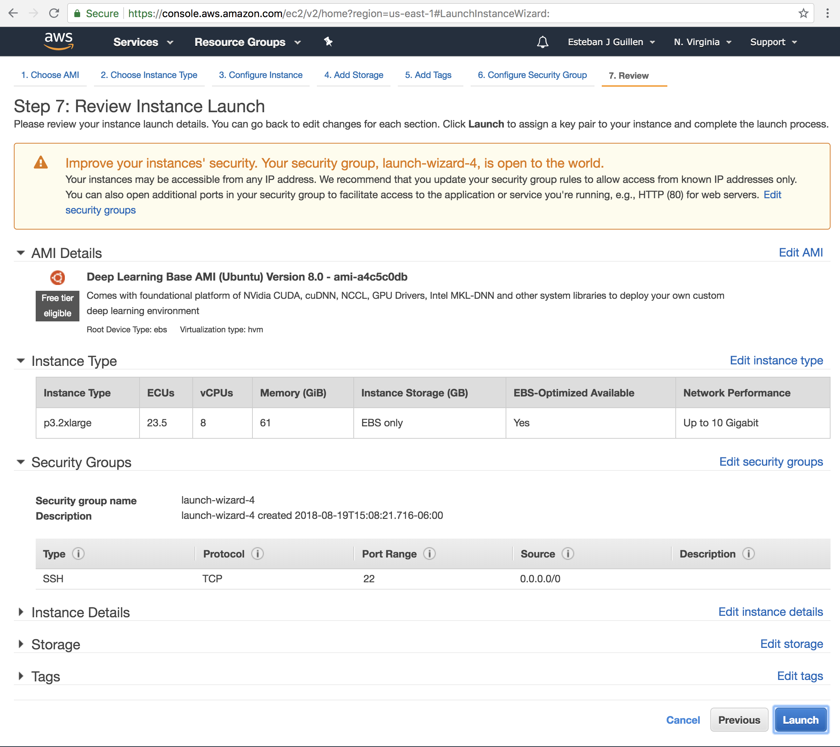
Launch
Notes:
Review and click Launch

Slide 8
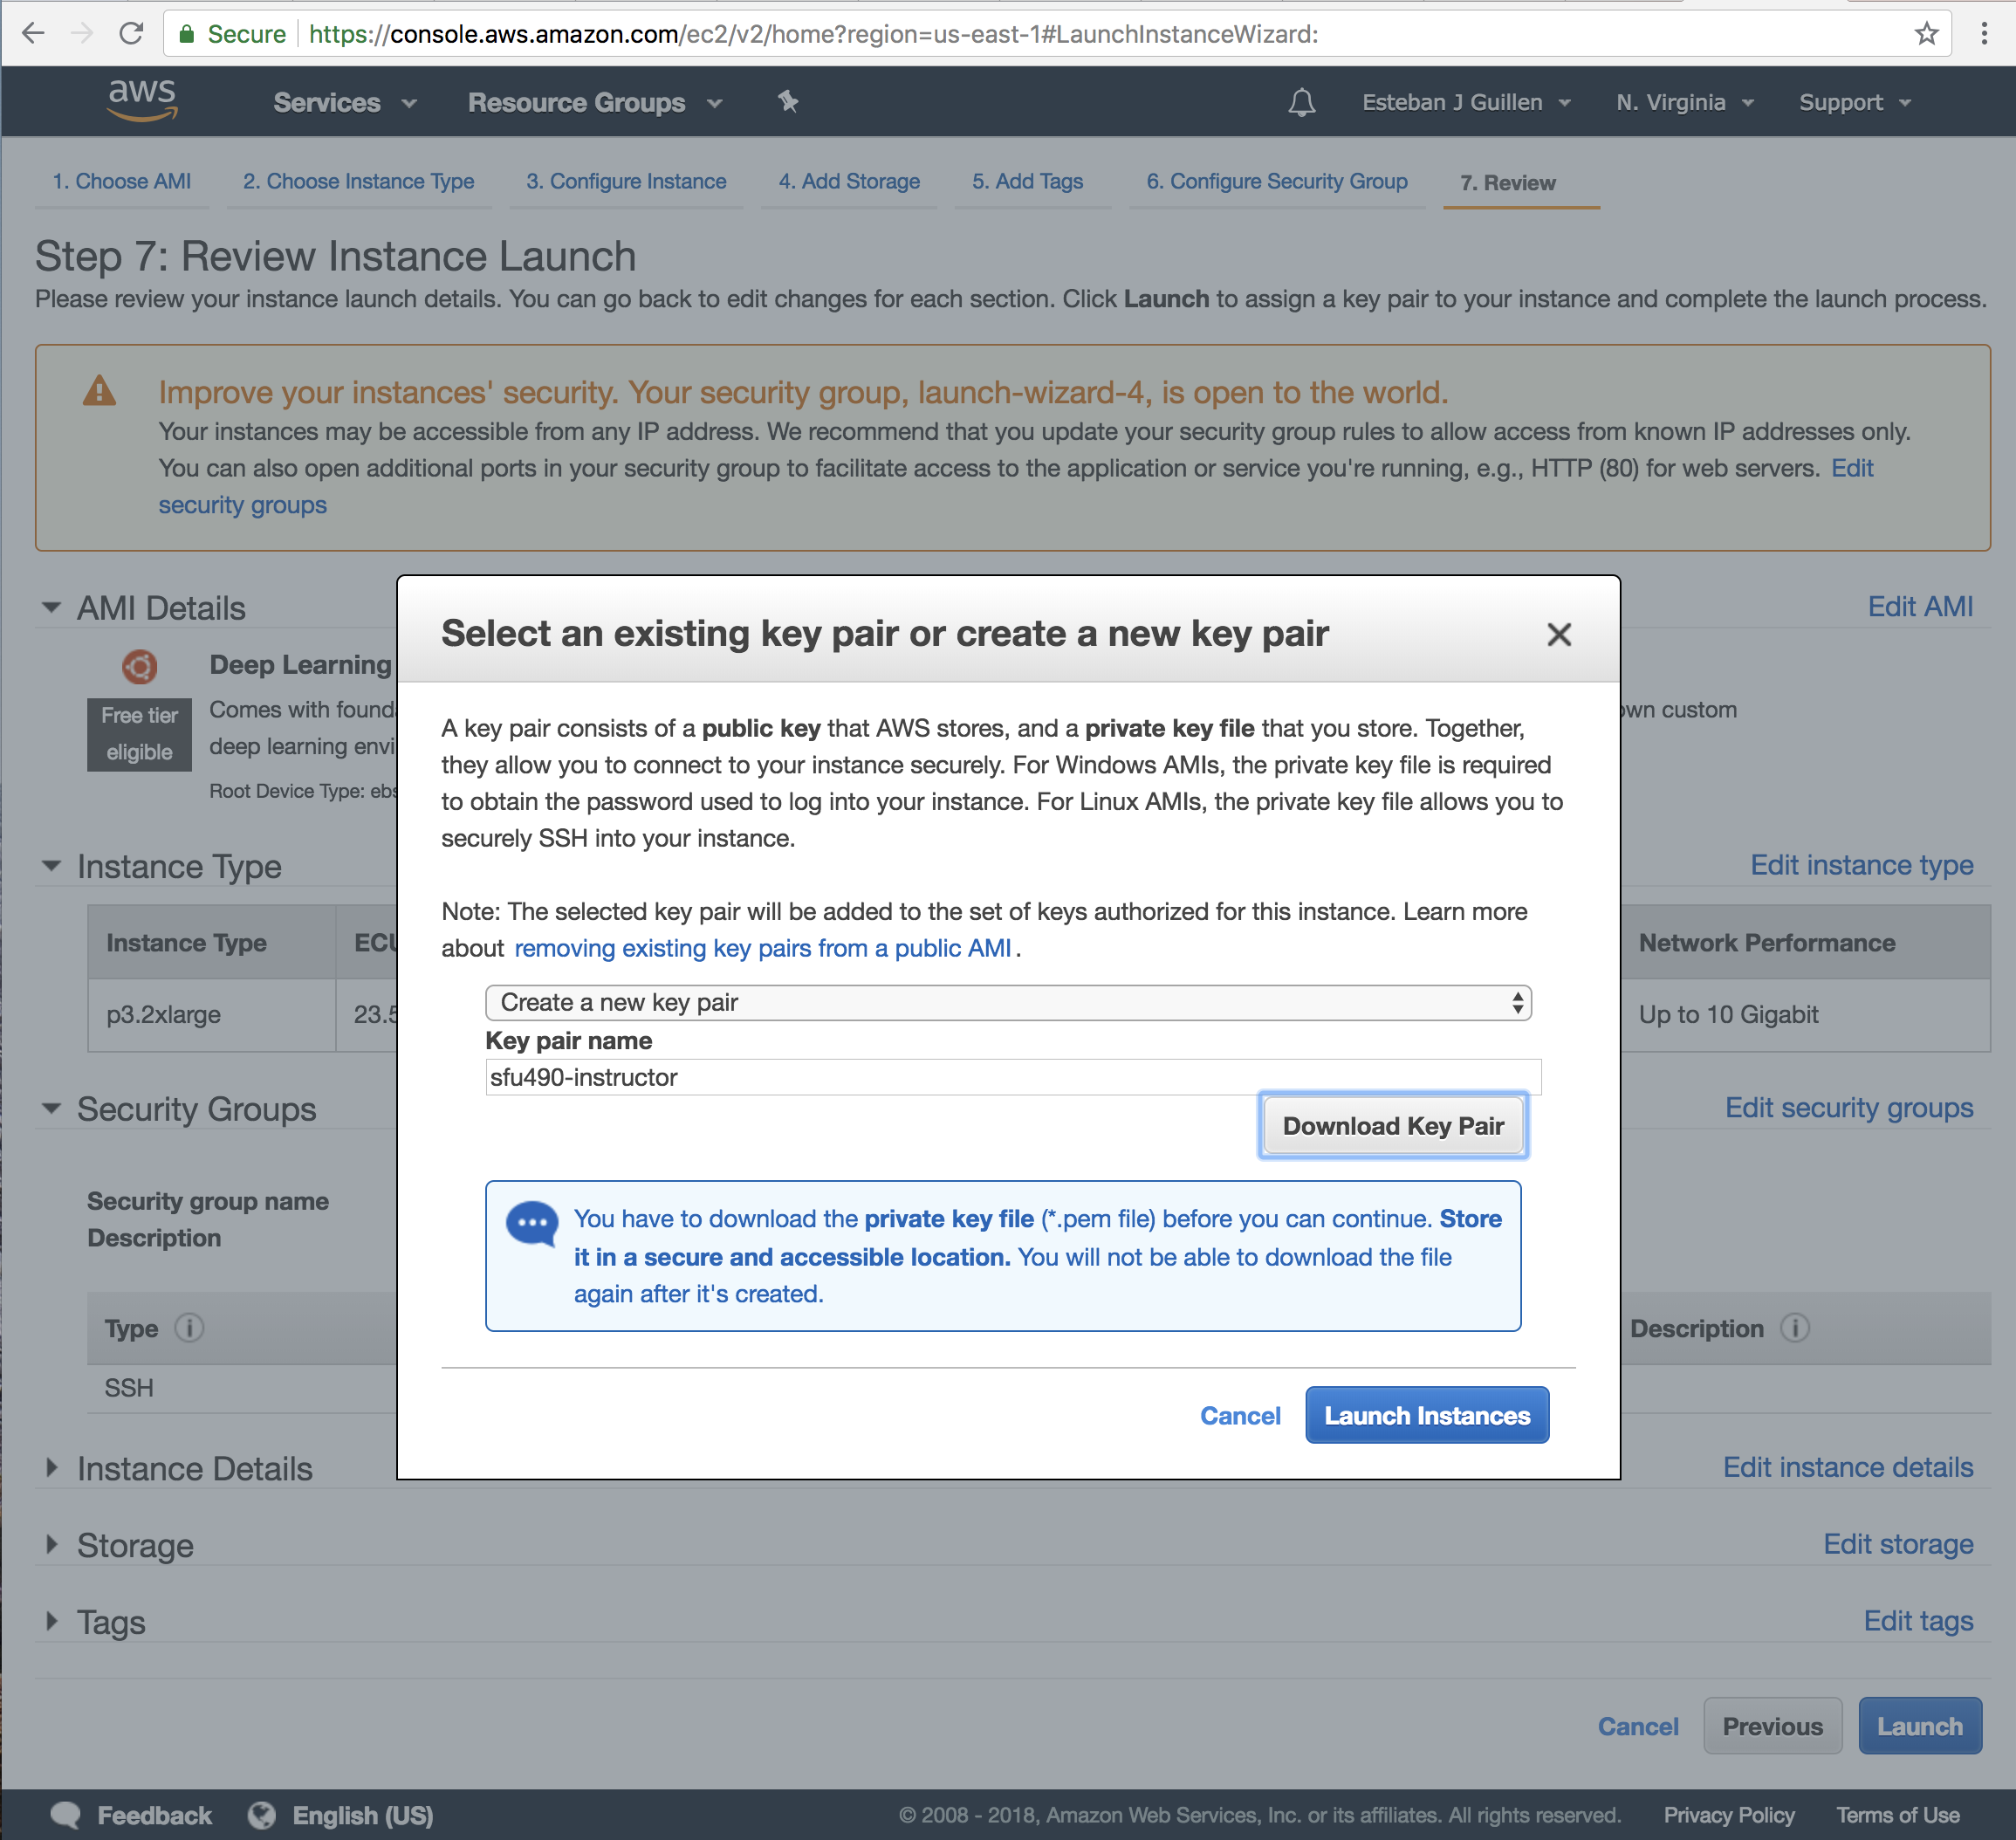
Download Key -> Launch Instance
Notes:
Make sure to download your .pem file and launch instance

Slide 9
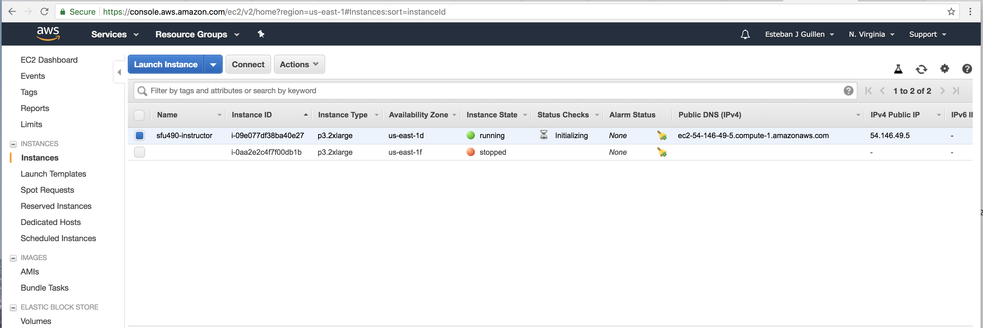
Select and Launch Instance
Notes:
You can now see you instance running

Slide 10
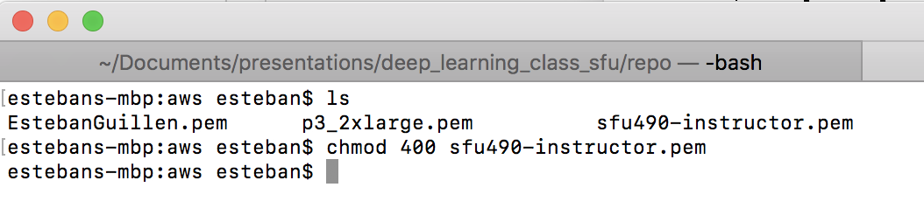
Change the permission on the .pem file
Notes:
Change the permissions on the .pem file

Slide 11
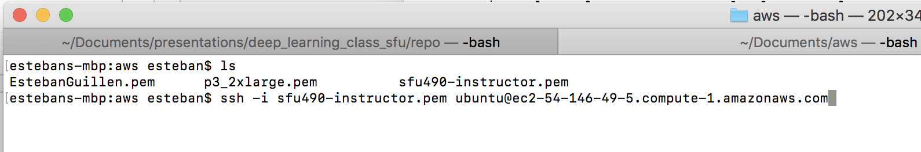
Connect to your Instance
https://docs.aws.amazon.com/quickstarts/latest/vmlaunch/step-2-connect-to-instance.html#sshclient
Notes:
Connect to your instance

Slide 12
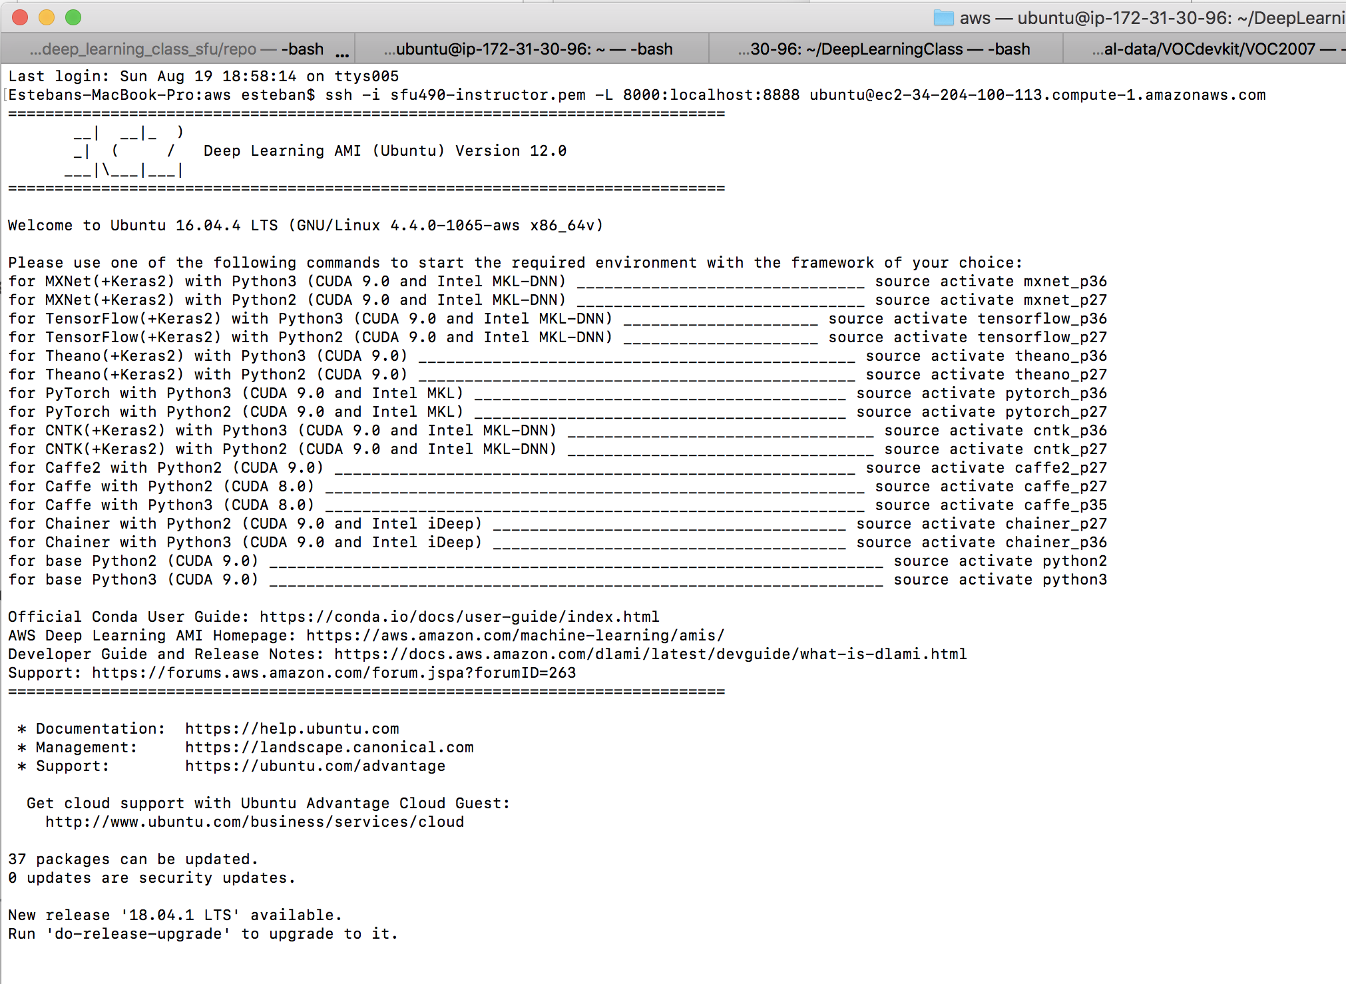
Your Connected

Slide 13
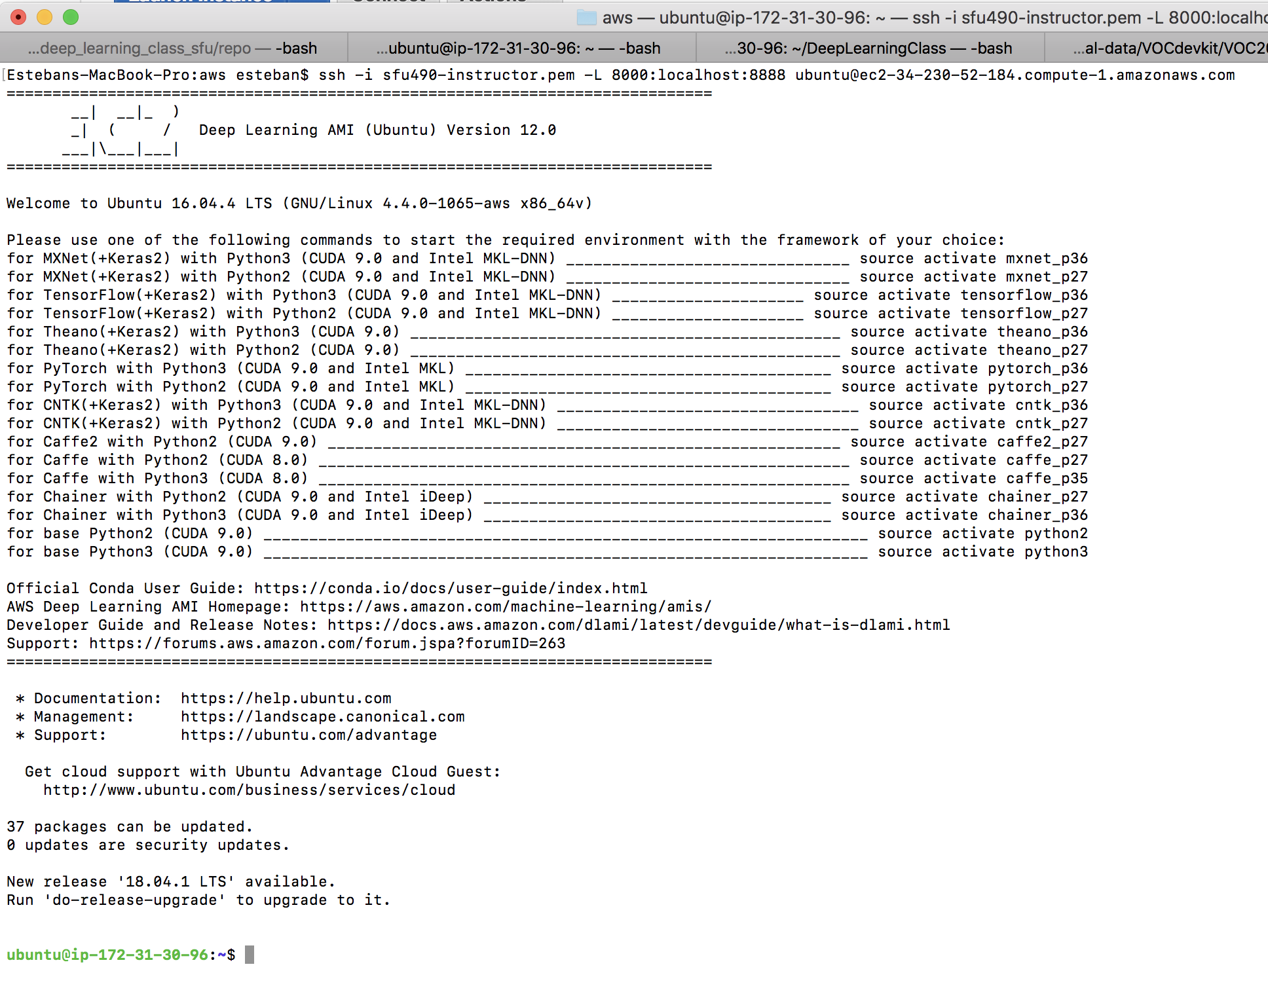
Start jupyter notebook server

Slide 14
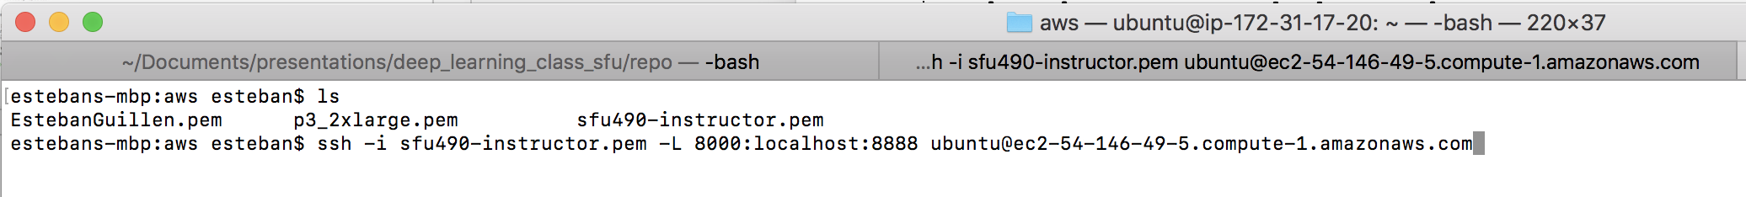
Create an ssh tunnel

Slide 15
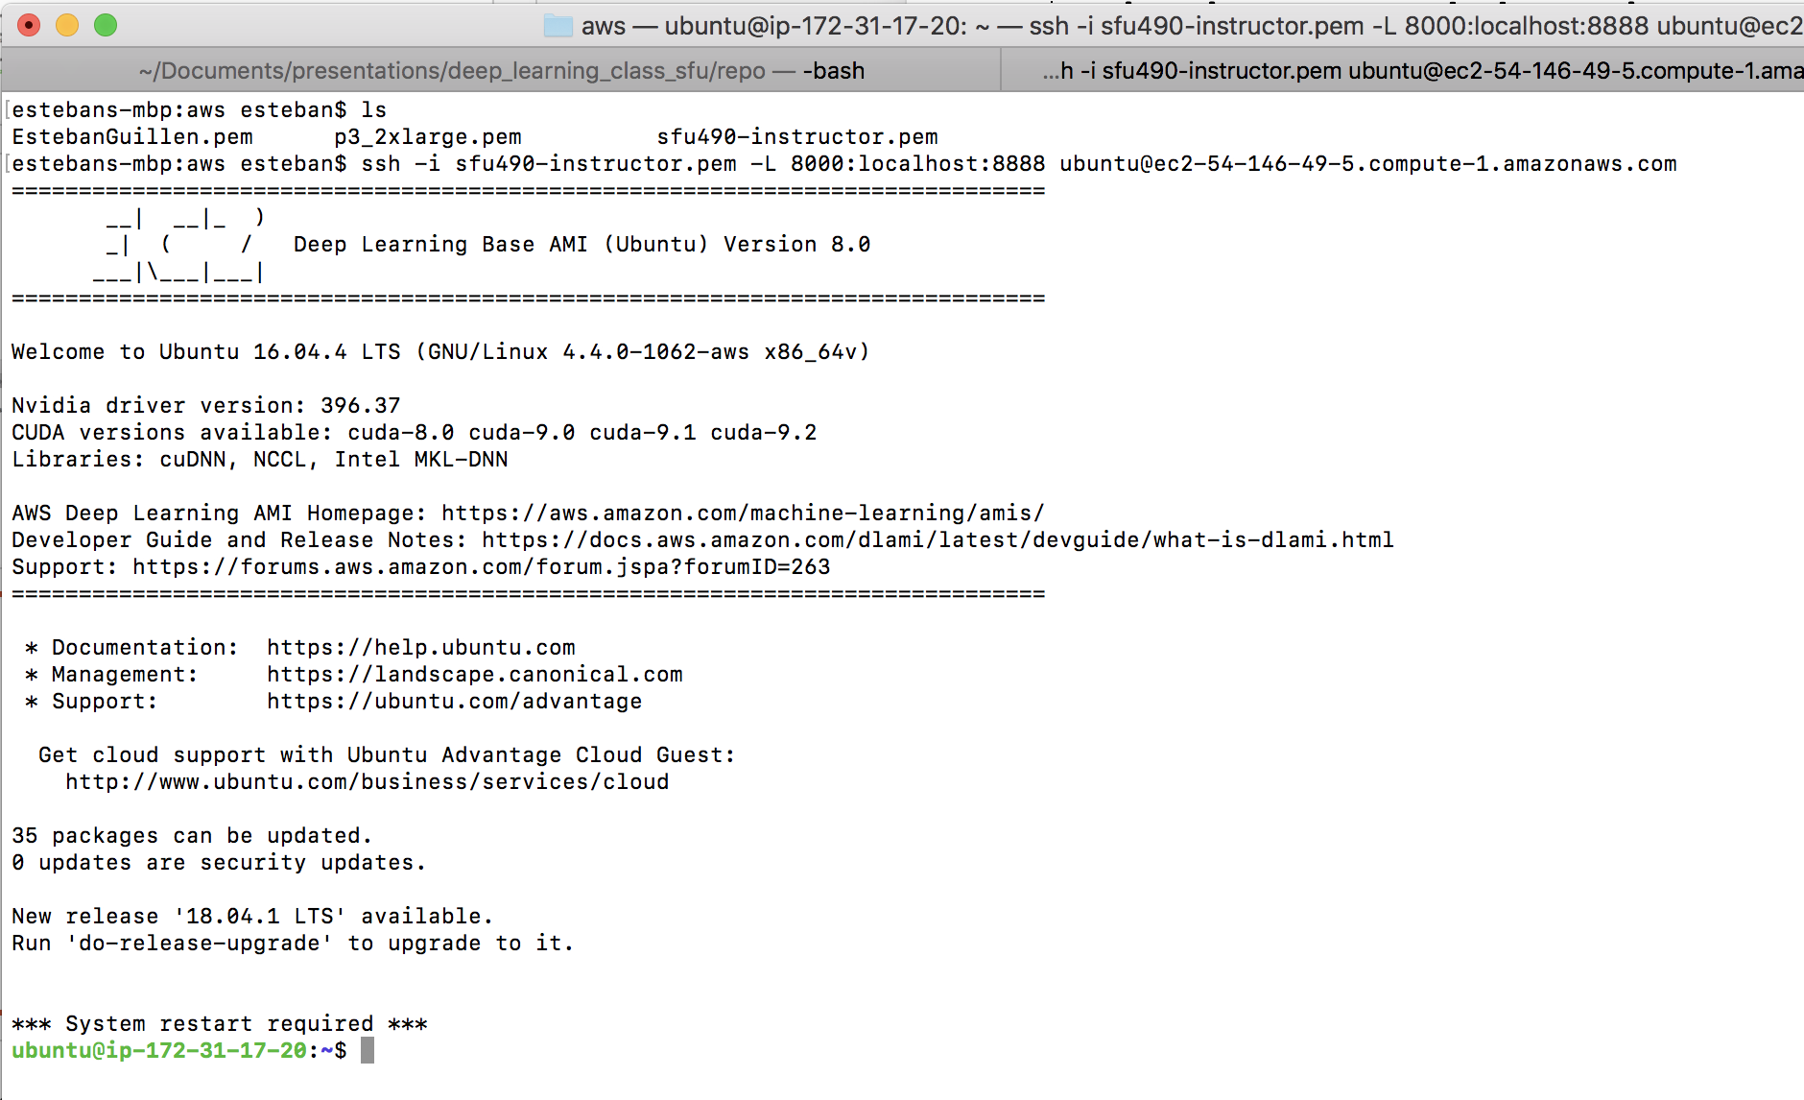
Ssh tunnel connected

Slide 16
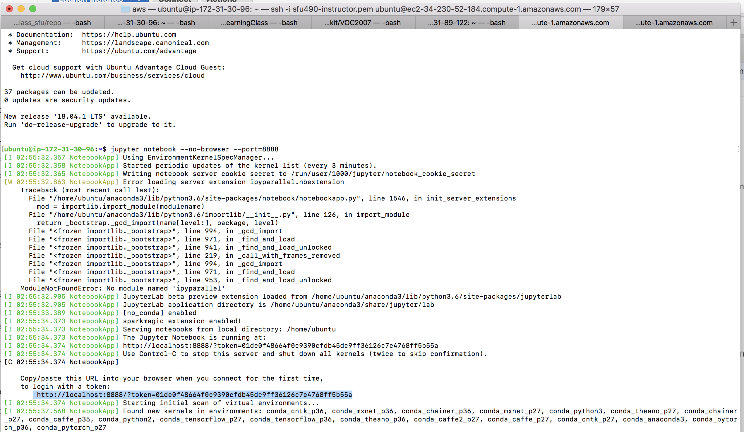
Copy login url

Slide 17

Paste URL into browser

Slide 18
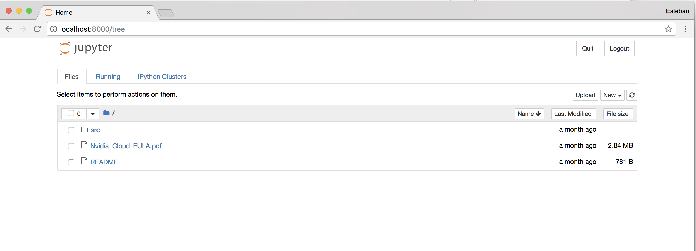
Notebook running on AWS

Slide 19
Commands to get Fast.ai installed
pip install --upgrade pip
pip install http://download.pytorch.org/whl/cu90/torch-0.4.0-cp36-cp36m-linux_x86_64.whl && pip install torchvision
pip install --upgrade fastai
pip install http://download.pytorch.org/whl/cu90/torch-0.4.0-cp36-cp36m-linux_x86_64.whl && pip install torchvision
pip install --upgrade scipy
pip install kaggle-cli
sudo apt-get install p7zip-full
pip install sklearn
Notes:
Install pytorch 0.4.0
install

Slide 20
Lesson 9 – Exercise
Test AWS
Notes:
Make sure everyone can connect

Slide 21
Lesson 10 – Improving performance
Hyperparameter tuning
Bias and Variance
Regularization
Dropout
Batch Normalization

Slide 22

Lesson 10 -Tuning is an iterative process
# layers
Idea
# hidden units
learning rates
activation functions
…
Experiment
Code
Notes:
You have to iterate many times to find the best parameters

Slide 23
Lesson 10 - Bias and Variance
high bias
“just right”
high variance
Underfitting
Overfitting

Slide 24
Lesson 10 - Bias and Variance
Cat classification
Train set error:
1%
15%
15%
0.5%
Dev set error:
11%
16%
30%
1.2%
High
Bias
High
Variance
&
High
Bias
Low
Variance
&
Low
Bias
High
Variance

Slide 25
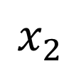
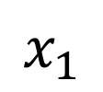
Lesson 10 - High bias and high variance
$$x_{2}$$
$$x_{1}$$

Slide 26
Lesson 10 – Fixing Bias and Variance problems
High bias
Create bigger network
Train longer
Find a better architecture
High variance
Get more data
Regularization
Find a better architecture

Slide 27
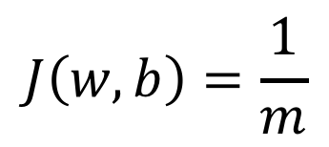
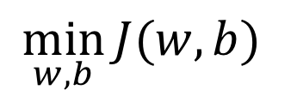
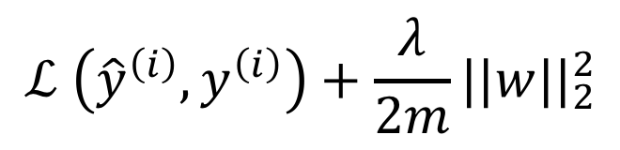

Lesson 10 - Regularization
$$\min_{w,b}{J(w,b)}$$
$$J\left(w,b\right)=\frac{1}{m}$$
$$\sum_{i=1}^{m}{ }$$
$$ℒ \left({\hat{y}}^{\left(i\right)},y^{\left(i\right)}\right)+\frac{λ}{2m}||w||_{2}^{2}$$
Notes:
Example is for logistic regression
Lambda is the regularization parameter (trial and error)
Weight decay
Prevents the weights from getting to large
Helps prevent overfitting

Slide 28
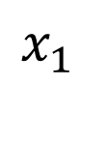
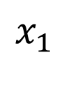
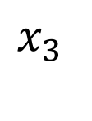
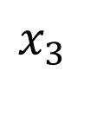
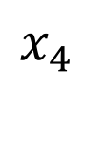
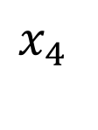
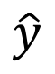
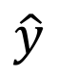
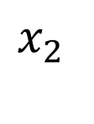
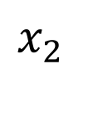
Lesson 10 - Dropout regularization
$$x_{1}$$
$$x_{1}$$
$$x_{2}$$
$$x_{2}$$
$$\hat{y}$$
$$\hat{y}$$
$$x_{3}$$
$$x_{3}$$
$$x_{4}$$
$$x_{4}$$
Notes:
With some probability p choose nodes to remove from the network (or freeze)
Training on a much smaller network, helps prevent overfitting
Can’t rely on any one feature, so have to spread out weights (shrinks weights similar to L2 regularization)
Implemented with “Inverted dropout”
No dropout at test time
Mostly used in Computer Vision

Slide 29
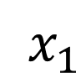
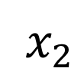
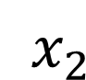
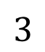
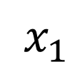
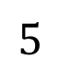
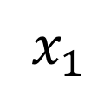
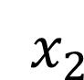
Lesson 10 - Normalizing data
$x_{2}$
$x_{2}$
$$3$$
$x_{2}$
$x_{1}$
$x_{1}$
$x_{1}$
$$5$$
Notes:
Always a good idea to normalize the data, usually centered around zero
Use same normalization constants (mu and sigma) on your test set

Slide 30
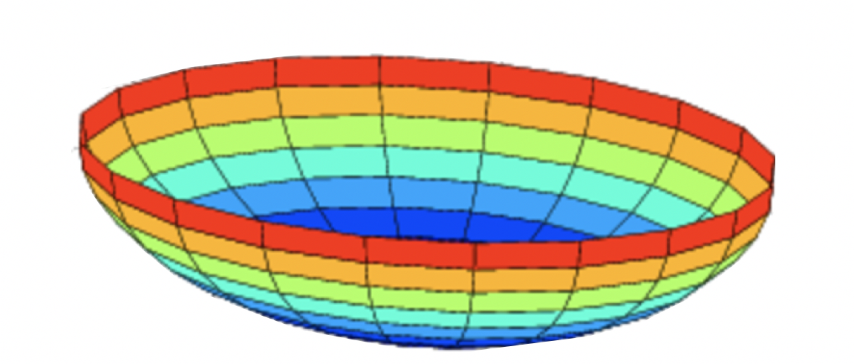
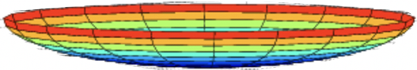
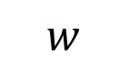
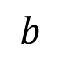

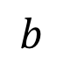
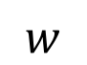

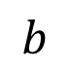
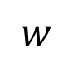

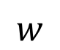
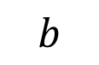

Lesson 10 - Why normalize inputs
$$J\left(w,b\right)=\frac{1}{m}$$
$$\sum_{i=1}^{m}{ }$$
Unnormalized:
Normalized:
$$ℒ ({\hat{y}}^{\left(i\right)},y^{(i)})$$
$$J$$
$$J$$
$$w$$
$$w$$
$$b$$
$$b$$
$$b$$
$$b$$
$$w$$
$$w$$
Notes:
Speeds up training if data is normalized
If data is unnormalized we can take steps in the wrong direction

Slide 31









Lesson 10 – Batch Normalization
$$x_{1}$$
$$w,b$$
$$x_{2}$$
$$\hat{y}$$
$$x_{3}$$
$$x_{1}$$
$$x_{2}$$
$$\hat{y}$$
$$x_{3}$$

Slide 32
Lesson 10 - Exercise
Adding Dropout and Batch Norm to MNIST

Slide 33

Lesson 10 – 15 minute Break

Slide 34

Lesson 11 – Multi-label Classification
Notes:
Make the point that the final layer is a sigmoid rather than a softmax

Slide 35
Lesson 11 - Exercise
Planet notebook

Slide 36
Lesson 11 – 15 minute Break

Slide 37
Lesson 12 – CNN Architectures
Classic networks
LeNet-5
AlexNet
VGG
ResNet
Inception

Slide 38










Lesson 12 - LeNet - 5
avg pool
avg pool
$$\hat{y}$$
5$×$ 5
s = 1
f = 2
s = 2
5$×$ 5
s = 1
f = 2
s = 2
$$⋮$$
$$⋮$$
32$×$32 $×$1
28$×$28$×$6
14$×$14$×$6
10$×$10$×$16
5$×$5$×$16
120
84
[LeCun et al., 1998. Gradient-based learning applied to document recognition]
Notes:
Classic architecture from the late 90’s and was developed to recognize handwritten digits
60k parameters
Avg pooling instead of max pooling
Sigmoid/tanh instead of ReLU

Slide 39




















Lesson 12 - AlexNet
MAX-POOL
MAX-POOL
11$×$ 11
s = 4
3$×$ 3
s = 2
5$×$ 5
s=1
same
3$×$ 3
s = 2
55$×$55 $×9$6
27$×$27 $×$96
27$×$27 $×$256
13$×$13 $×$256
227$×$227 $×$3
MAX-POOL
=
3$×$ 3
s=1
same
3$×$ 3
s=1
same
3$×$ 3
s=1
same
3$×$ 3
s = 2
$$⋮$$
$$⋮$$
$$⋮$$
Softmax
1000
13$×$13 $×$384
13$×$13 $×$384
13$×$13 $×$256
6$×$6 $×$256
9216
4096
4096
[Krizhevsky et al., 2012. ImageNet classification with deep convolutional neural networks]
Notes:
Similar to LeNet but a lot bigger (60M parameters)
ReLU
Multiple GPUs
Game changer, convinced people that Deep Learning was a viable technique for Computer Vision

Slide 40

Lesson 12 - AlexNet – ”Game Changer”

Slide 41


















Lesson 12 - VGG - 16
CONV = 3$×$3 filter, s = 1, same
MAX-POOL = 2$×$2 , s = 2
224$×$224$×$64
112$×$112 $×$64
112$×$112 $×$128
56$×$56 $×$128
[CONV 64]
$×$2
POOL
[CONV 128]
$×$2
POOL
224$×$224 $×$3
56$×$56 $×$256
28$×$28 $×$256
28$×$28 $×$512
14$×$14$×$512
[CONV 256]
$×$3
POOL
[CONV 512]
$$×3$$
POOL
14$×$14 $×$512
7$×$7$×$512
FC
FC
Softmax
[CONV 512]
$×$3
POOL
4096
4096
1000
[Simonyan & Zisserman 2015. Very deep convolutional networks for large-scale image recognition]
Notes:
Simple set of hyperparameters
CONV = 3x3 filter, s=1, same padding
Max pool = 2x2, s=2
Simplified the architecture
x2 means to do the conv operation twice
x3 means to do the conv operation three times
16 layers that has weights
138M parameters

Slide 42














Lesson 12 - Residual block
$$a^{[l+1]}$$
Plain
$$a^{[l]}$$
$$a^{[l+2]}$$
$$z^{[l+1]}{=W}^{[l+1]}a^{[l]}+b^{[l+1]}$$
$$a^{[l+1]}=g(z^{[l+1]})$$
$$z^{[l+2]}= W^{[l+2]}a^{[l+1]}+b^{[l+2]}$$
$$a^{[l+2]}=g(z^{[l+2]})$$
Residual
$$a^{[l+1]}$$
$$a^{[l]}$$
$$a^{[l+2]}$$
$$z^{[l+1]}{=W}^{[l+1]}a^{[l]}+b^{[l+1]}$$
$$a^{[l+1]}=g(z^{[l+1]})$$
$$z^{[l+2]}= W^{[l+2]}a^{[l+1]}+b^{[l+2]}$$
$$a^{[l+2]}=g(z^{\left[l+2\right]}+a^{[l]})$$
[He et al., 2015. Deep residual networks for image recognition]

Slide 43


Lesson 12 - Residual Network
$$x$$
$$a^{[l]}$$
Plain
ResNet
training error
training error
# layers
# layers
[He et al., 2015. Deep residual networks for image recognition]

Slide 44

Lesson 12 - ResNet
Notes:
Why do residual networks work?
Skip connection can simply learn an identity mapping to it doesn’t hurt performance and often improves it
When the dimension increases (color coded) the dotted line highlights the need to perform some type of operation to match up the dimensions

Slide 45









Lesson 12 - Why does a 1 $×$ 1 convolution do?
1 | 2 | 3 | 6 | 5 | 8
3 | 5 | 5 | 1 | 3 | 4
2 | 1 | 3 | 4 | 9 | 3
4 | 7 | 8 | 5 | 7 | 9
1 | 5 | 3 | 7 | 4 | 8
5 | 4 | 9 | 8 | 3 | 5
$$∗$$
2
$$=$$
6 $×$ 6
$$∗$$
$$=$$
6 $×$ 6 $×$ 32
1 $×$ 1 $×$ 32
6 $×$ 6 $×$ # filters
[Lin et al., 2013. Network in network]
Notes:
A 1x1 2-d filter convolved over a 2-d input volume isn’t all that interesting
But a 1x1x # number of channels convolved of a 3-d input volume can reduce that number of channels
Where max pooling reduces the height and width (and leaves the channels unchanged)

Slide 46




Lesson 12 - Using 1$×$1 convolutions
ReLU
CONV 1 $×$ 1 $×$ 192
32
28 $×$ 28 $×$ 32
28 $×$ 28 $×$ 192
[Lin et al., 2013. Network in network]
Notes:
A way to shrink the number of channels

Slide 47




Lesson 12 - Motivation for inception network
1 $×$ 1 $×$ 192 (64)
3 $×$ 3 $×$ 192 (128)
same
64
5 $×$ 5 $×$ 192 (32)
same
128
28
32
32
28
28 $×$ 28 $×$ 192
MAX-POOL
same
s=1
[Szegedy et al. 2014. Going deeper with convolutions]
Note: the colors are intended to correspond to the stacked small hand drawn cube
Notes:
Rather than having to choose a specific size of filter, just use many different sizes

Slide 48


Lesson 12 - The problem of computational cost
CONV
5 $×$ 5 $×$ 192,
same,
32
28 $×$ 28 $×$ 32
28 $×$ 28 $×$ 192
# of multiplies: 28 x 28 x 32 x 5 x5 x 192 = 120M
# parameters: 5 x 5 x 192 x 32 = 153,600
Notes:
There is a problems with this exact implementation, the computation cost would be to high

Slide 49






Lesson 12 - Using 1$×$1 convolution
Bottleneck layer
CONV
1 $×$ 1 $×$ 192,
16
CONV
5 $×$ 5 $×$ 16,
32
28 $×$ 28 $×$ 16
28 $×$ 28 $×$ 32
28 $×$ 28 $×$ 192
# of multiplies: (28 x 28 x 16 x 1 x1 x 192) + (28 x 28 x 32 x 5 x 5 x 16) = 12.4M
# parameters: (1 x 1 x 192 x 16) + (5 x 5 x 16 x 32) = 18,899

Slide 50








Lesson 12 - Inception module
1 $×$ 1 CONV
1 $×$ 1 CONV
3 $×$ 3 CONV
Previous Activation
Channel Concat
1 $×$ 1 CONV
5 $×$ 5 CONV
MAXPOOL 3 $×$ 3,s = 1 same
1 $×$ 1 CONV

Slide 51


Lesson 12 - Inception network
[Szegedy et al., 2014, Going Deeper with Convolutions]
Notes:
Full Inception network sometimes called GoogLeNet

Slide 52
Lesson 12 - Exercise
Distracted Driver notebook
Try different architectures

Slide 53
Lesson 12 – 15 minute Break

Slide 54

Lesson 13 - Localization and Detection
Image classification
Classification with
localization
Detection
Notes:
We already understand image classification, ”is there a car in the image” or “is there a cat in the image”, etc.
Now we might want to know not only if a certain class exists within the image, but also where in the image it is located and draw a bounding box around it
We would call this classification with localization
In the more general case we might have the need to detect multiple objects from different classes and draw bounding boxes for each

Slide 55


Lesson 13 - Classification with localization
$$⋯$$
$$⋮$$
1 - pedestrian
2 - car
3 - motorcycle
4 - background

Slide 56

Lesson 13 - Defining the target label y
1 - pedestrian
Need to output $b_{x},b_{y},b_{h}, b_{w},$class label (1-4)
2 - car
3 - motorcycle
4 - background

Slide 57
Lesson 13 - Exercise
Object Detection notebook
A lot of code
Focus on the parts relevant to object detection

Slide 58
Lesson 13 – 15 minute Break

